Slide 1
SENTIMent ANAlysis of covid-19 tweets – visualization dashboard
Submitted by:
Jeeva K
Sourav R
Abinaya S
Dhivyabharathi S

Slide 2
abstract:
This project addresses the problem of sentiment analysis in twitter that is classifying tweets according to the sentiment expressed in them: positive, negative or neutral. Twitter is a social-networking platform which allows users to write short status updates of maximum length 140 characters.
It is a rapidly expanding service with over 200 million registered users - out of which 100 million are active users and half of them log on twitter on a daily basis - generating nearly 250 million tweets per day. Due to this large amount of usage we hope to achieve a reflection of public sentiment by analysing the sentiments expressed in the tweets. Analysing the public sentiment is important for many applications such as firms trying to find out the response of their products in the market, predicting political elections and predicting socioeconomic phenomena like stock exchange.
The dashboard provides visibility into the social media discussions around Coronavirus and the quality of information shared on the platform, updated over time. The dashboard maintains an evolving list of corona, COVID19, pandemic, lockdown, lockdown extended, quarantine.

Slide 3
STEPS INVOLVED:
Step 1: Create data files for the classifier.
(1.1) Create a file of tweets with their sentiment of each sentiment analyzer.
(1.2) Save it as CSV file
Step 2: Execution of CSV on Twitter File.
(2.1) Load the file of tweets with their labeled sentiment.
(2.2) Apply the StringToWordVector filter .
(2.3) Apply the percentage split approach with 70%.
(2.4) Execute and save the results in the output file.

Slide 4
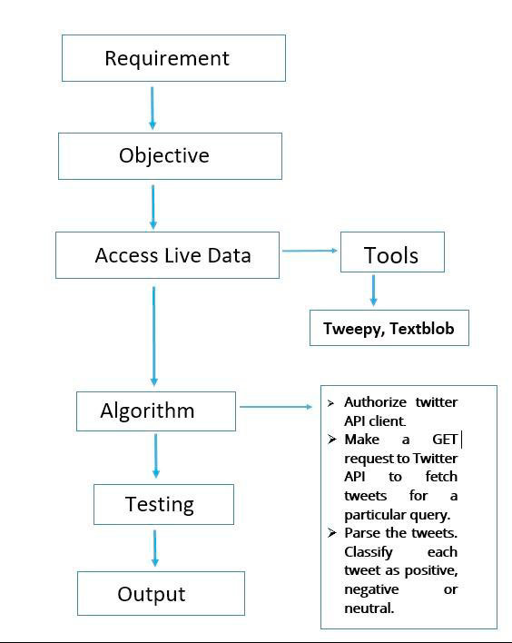
BLOCK Diagram:

Slide 5
Technology used:
1) TextBlob
2) Tweepy
3) NLP
4) Google chart
5) HTML , Css

Slide 6
Application:
Twitter sentiment analysis dashboard allows us to keep track of what's being said about your product or service on social media, and can help you detect angry customers or negative mentions before they turn into a major crisis. At the same time, Twitter sentiment analysis can provide interesting insights.
Colleges
Hospitals
IT industry
Feedback analysis of any application

Slide 7
Advantages:
Easy to display the statistics of real time data.
Easy to get the sentiment analysis of people from all kind of survey.
n number of data’s can be used for the analysis.
Best way of getting the opinion of people about a particular topic.
Can be used even in small scale industries to understand the opinion of employees and customers.
It can also be accessible through mobile.

Slide 8
Disadvantages:
We need to keep reviews current and up to date. Otherwise they will seem out of date and irrelevant.
Sometimes it may not be the complete replacement of reading survey responses.

Slide 9

OUTput:

Slide 10
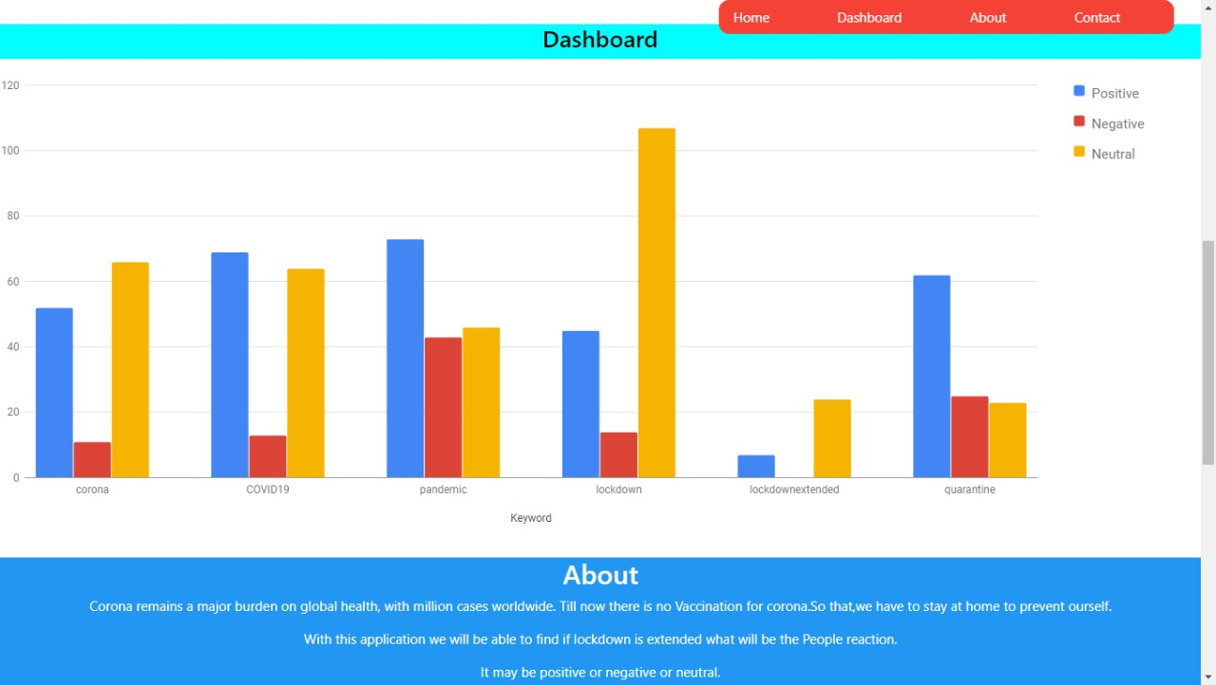

Slide 11
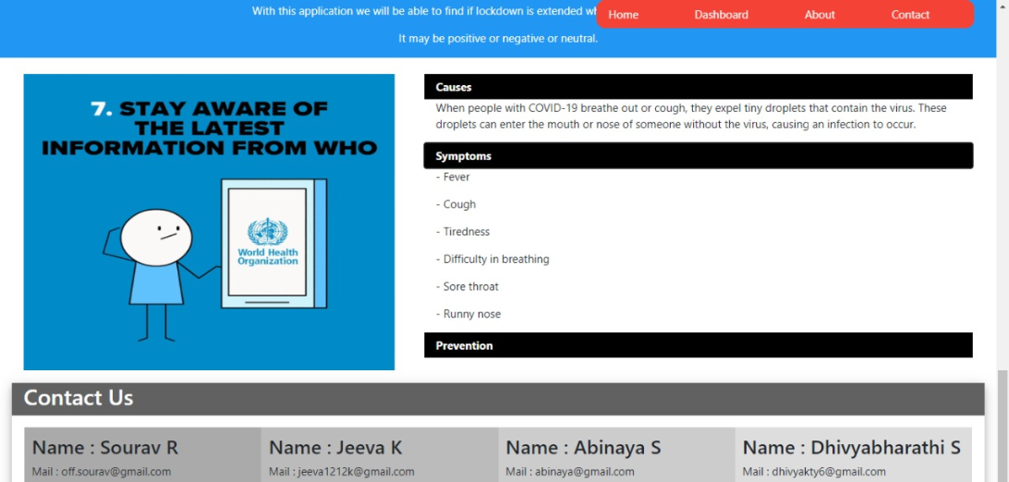

Slide 12
Conclusion:
Nowadays, sentiment analysis or opinion mining is a hot topic in machine learning. We are still far to detect the sentiments of s corpus of texts very accurately because of the complexity in the English language and even more if we consider other languages such as Chinese.
In this project we tried to show the basic way of classifying tweets into positive , neutral or negative category using Naive Bayes as baseline and how language models are related to the Naive Bayes and can produce better results.
We could further improve our classifier by trying to extract more features from the tweets, trying different kinds of features, tuning the parameters of the naïve Bayes classifier, or trying another classifier all together.

Slide 13


